Slide 1
Thinking of Carbon As a Crop
Notes:
GO TO VIEW > MASTER > SLIDE MASTER TO EDIT THE IMAGES ON THE TITLE AND DIVIDER SLIDES

Slide 2
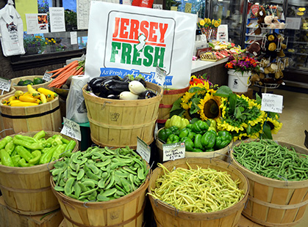
Notes:
We are blessed in New Jersey to be able to grow the bountiful and variety of crops that we do. What I want to talk to you about today is that there are other products that farmers provide that other people are willing to pay for…

Slide 3
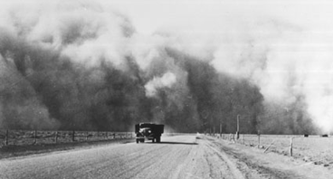
USDA Soil Conservation Service
Created during the Dust Bowl of the 1930’s
Notes:
Formed in the 1930’s, the Soil Conservation Service worked with agricultural producers to help keep the soil on their land and avoid another national disaster like the dust bowl.
Offices are established in most counties within the United States. In New Jersey we have 6 field offices located throughout the state.

Slide 4
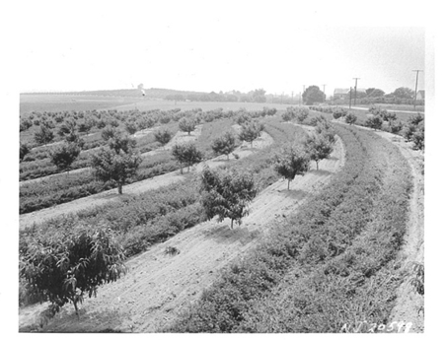
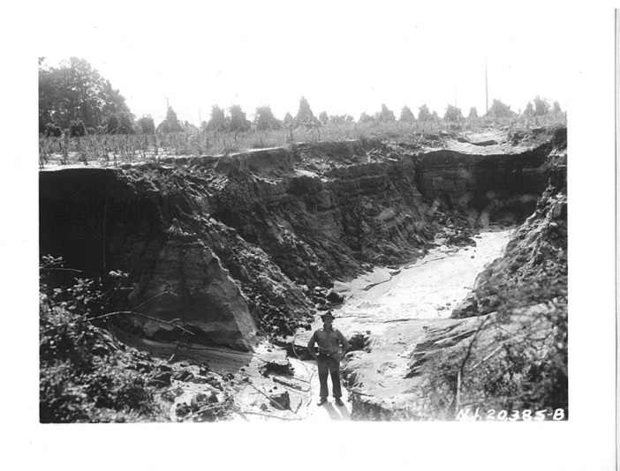
Early soil conservation in New Jersey
Notes:
While the Midwest was subject to wind erosion, New Jersey was struggling with wind and water erosion at that time. This is an example from Burlington county.

Slide 5
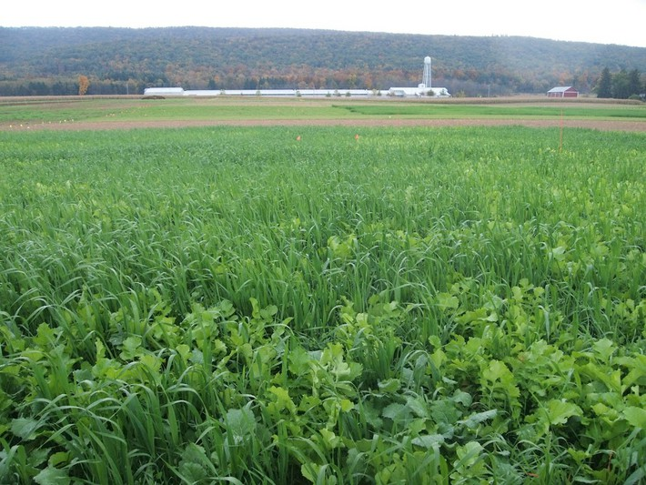
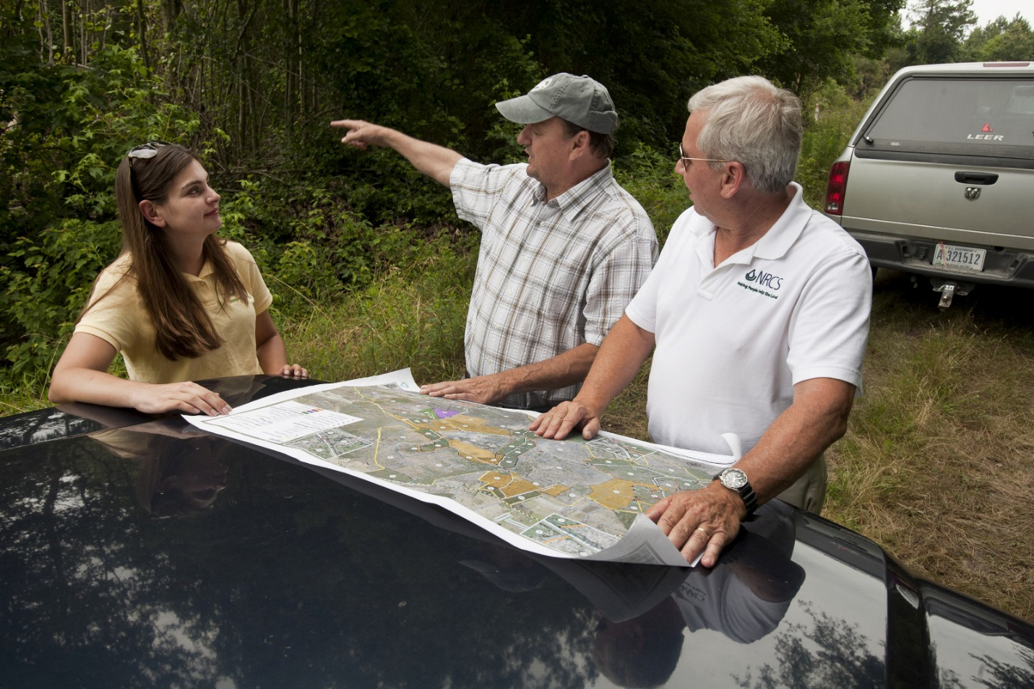
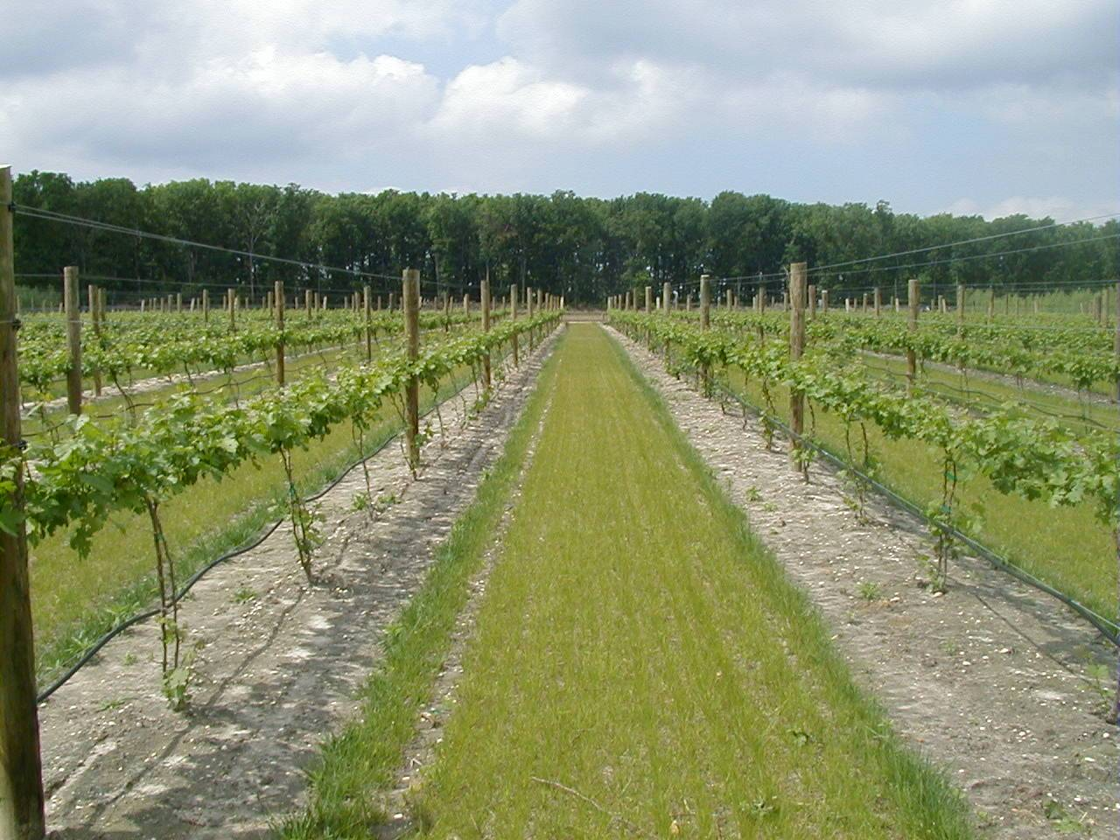
Today… Natural Resources Conservation Service
Notes:
As time passed, and as the SCS helped farmers with not just soil conservation but a host of other issues on their operations, the name was changed to the NRCS in 1994. We were still helping farmers take care of their of their piece of land.

Slide 6
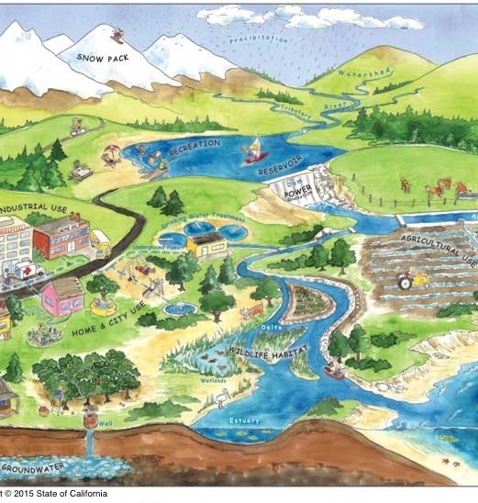
Environmental benefits are not contained by property lines…
Ecosystem
Services
Notes:
But you know and I know that when a farmer takes care of their land, benefits can be felt and seen beyond the fencelines and property boundaries. Often there are benefits to the environment that are experienced beyond the fencelines… to downstream users, to the community, to the ecosystem, to society. These are referred to as Ecosystem Services.

Slide 7
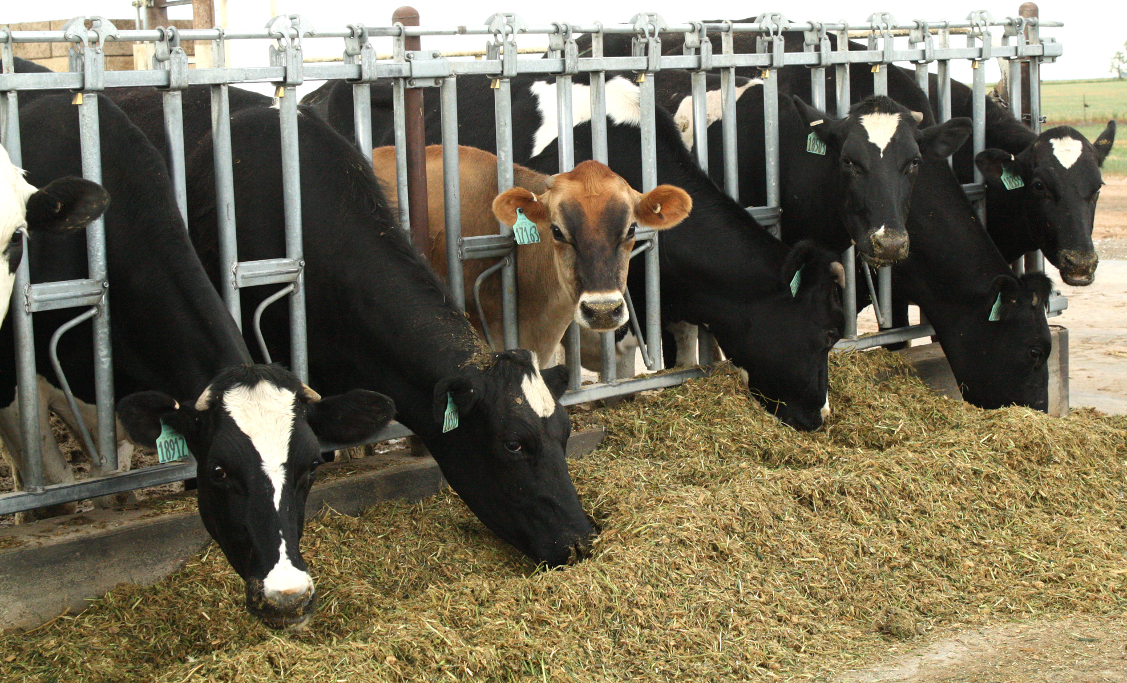
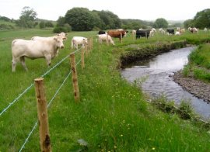
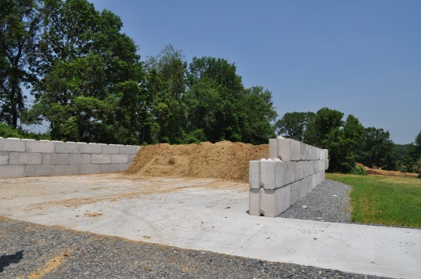
Ecosystem services examples:
Scenario 1 – Dairy
Notes:
Scenario 1 – A dairy producer works with NRCS to develop a Comprehensive Nutrient Management Plan (CNMP) and a conservation plan for their operation. The obtain assistance for an animal waste management system, a grazing plan, and fencing to protect the riparian areas.
Benefit to the farm – protect the farm resources, not too much phosphorus on the farm, healthy grass stand, stable banks for the stream. A healthy/balanced grazing system.
Ecosystem service provided - Improved water quality downstream with reduced levels of sediment and animal waste.

Slide 8
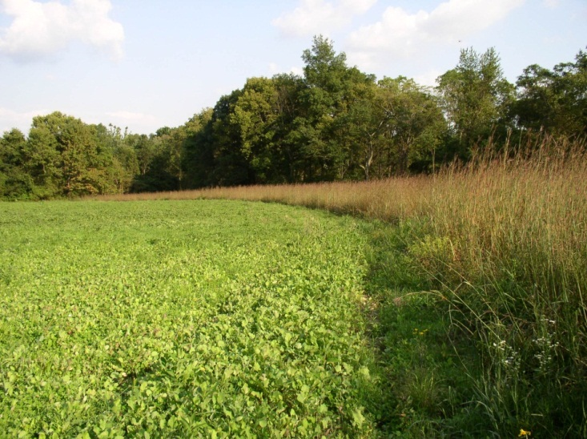
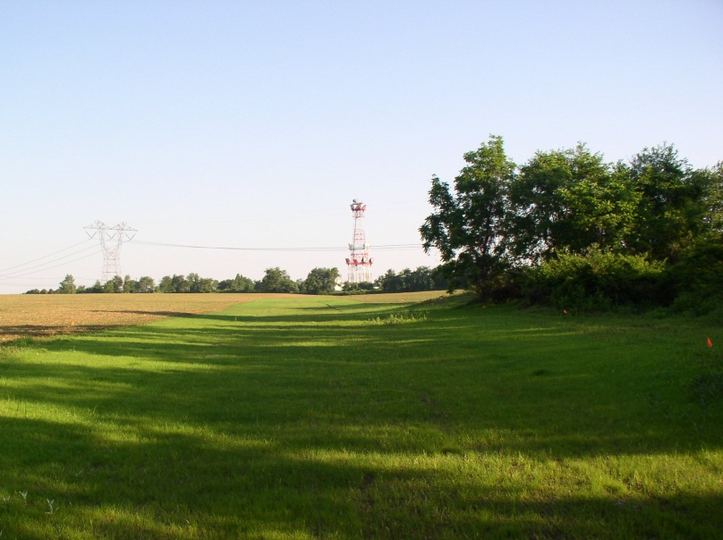
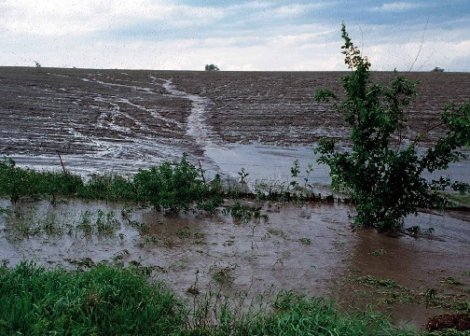
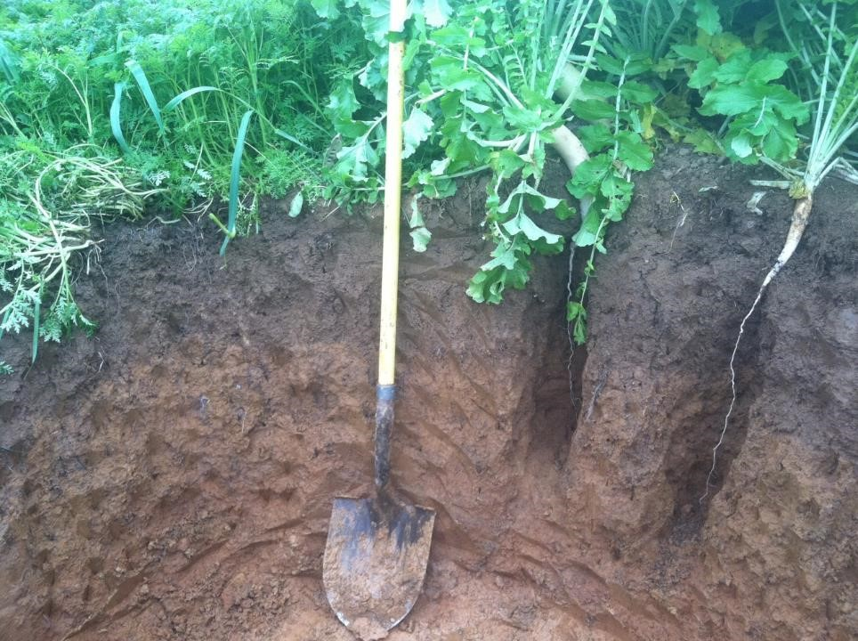
Ecosystem services examples:
Scenario 2 – Corn and soybean farmer
Notes:
A corn and soybean farmer has been reading a lot of articles about soil health and benefits of growing cover crops. He reaches out to NRCS who helps them develop a conservation plan that includes activities to improve the health of the soil. He receives an EQIP contract to help him install a waterway, convert to no-tillage and plant multi-species cover crops in between cash crops.
Benefit to farmer – less erosion and increasing organic matter within the soils on his farm.
Ecosystem services – less erosion into surface waters and increasing carbon within the soil which can off-set greenhouse gases.

Slide 9
Ecosystem services…
When ecosystem services can be measured and quantified, they can be sold and purchased through emerging markets.

Slide 10
Existing Environmental Markets
Water Quality
Wildlife Habitat
Carbon Sequestration
Notes:
USDA also has an Office of Environmental Markets

Slide 11
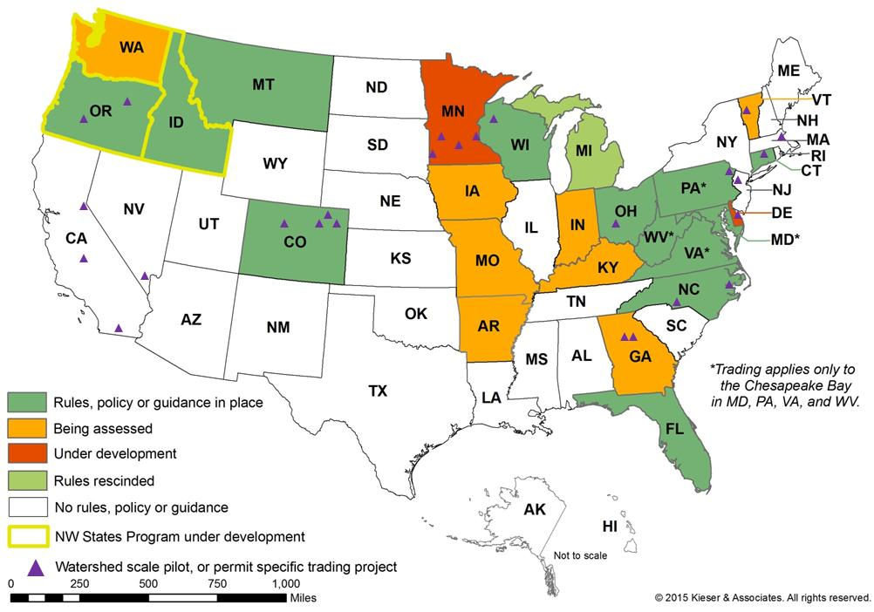

Slide 12
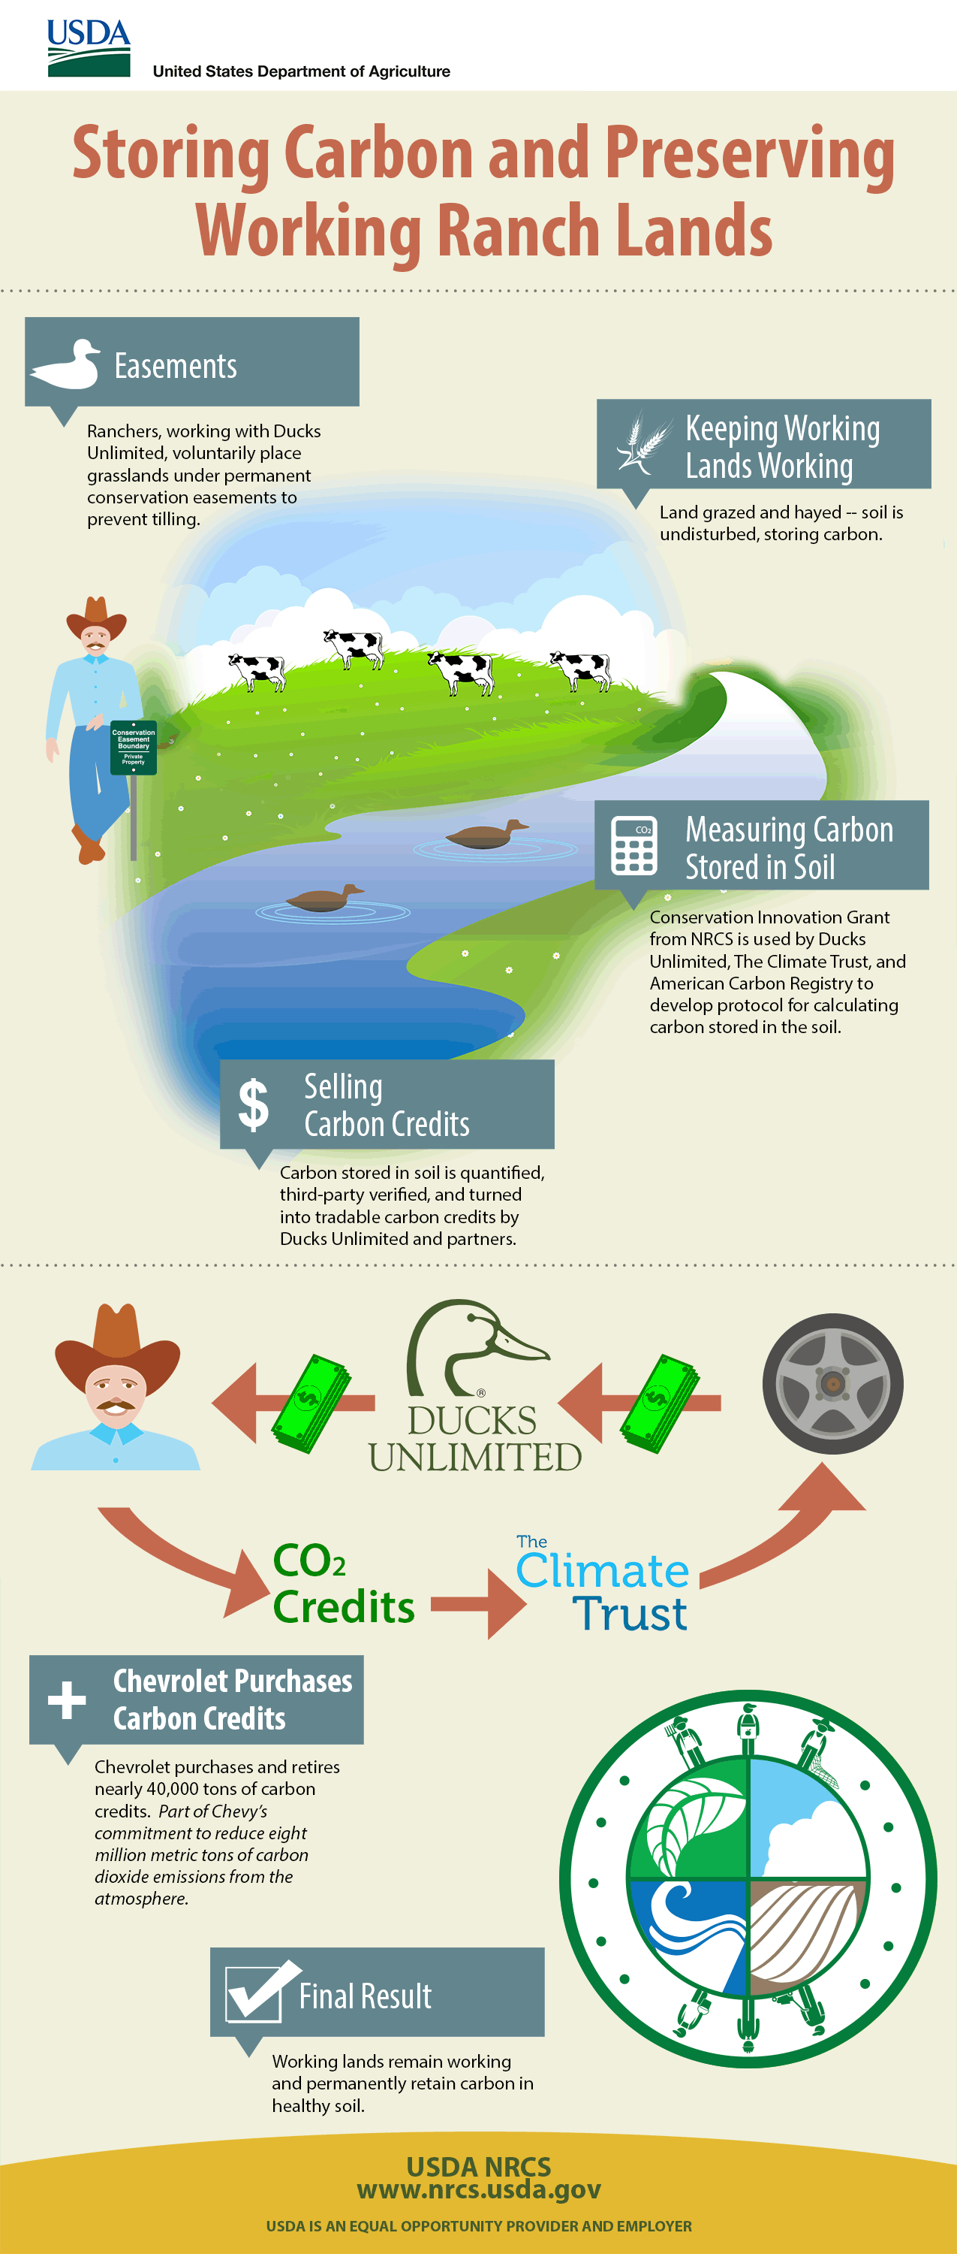
Examples

Slide 13
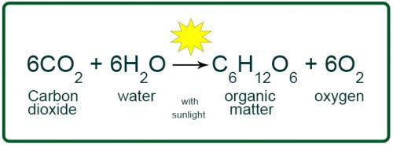
How is carbon added?
Photosynthesis
Notes:
By nature, farming is constantly creating carbon all the time.

Slide 14
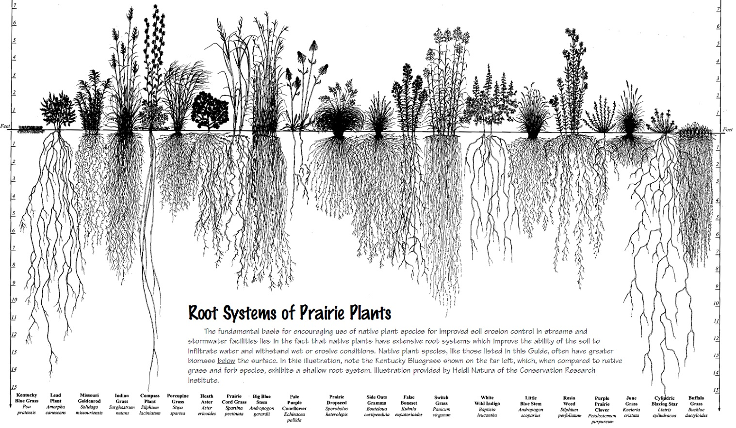
What is carbon?

Slide 15

Conservation Practices that add Carbon…
Higher Impact
Planting Trees and Shrubs
Conservation Cover
Deep rooted perennial plantings
Reducing Tillage
Windbreaks

Slide 16

Conservation Practices that add Carbon……
Medium Impact
Contour buffer strips
Riparian Forest Buffer
Vegetative Barriers
Windbreak renovations

Slide 17

Conservation Practices that add Carbon……
Lower impact
Riparian Herbaceous cover
Residue Management

Slide 18
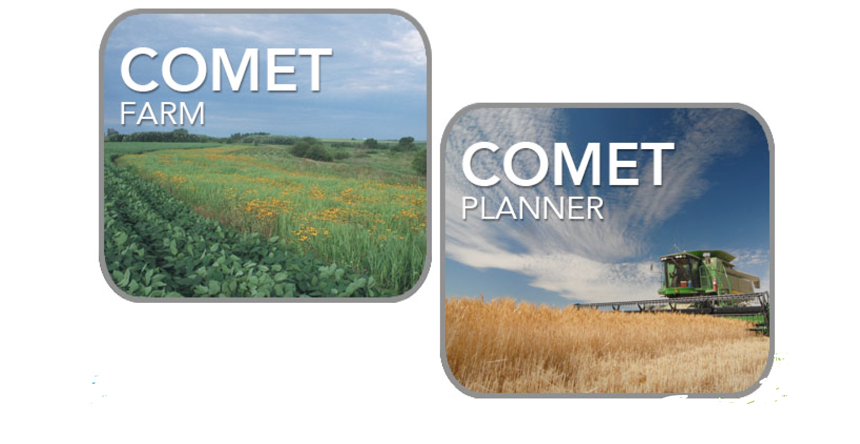
Carbon Quantification Tools
Notes:
Remember earlier when I said… When ecosystem services can be measured and quantified, they can be sold and purchased through emerging markets.
Comet Planner is intended to provide generalized estimates of the greenhouse gas impacts of conservation practices for initial planning purposes. Visit the Comet Planner website and read the COMET Planner report .
COMET-FARM™ is a whole farm and ranch carbon and greenhouse gas accounting system. The tool guides you through describing your farm and ranch management practices including alternative future management scenarios. Once complete, a report is generated comparing the carbon changes and greenhouse gas emissions between your current management practices and future scenarios.
Indigo Ag – requires that soil samples be taken to estimate carbon level changes and $15 per ton
Nori – sells ag carbon as a block chain and uses COMET-Farm as the measuring tool

Slide 19
Using USDA Farm Bill programs to help pay for these activities
Environmental Quality Incentives Program (EQIP)
Conservation Stewardship Program (CSP)
Conservation Reserve Program (CRP)
Agriculture Conservation Enhancement Programs (ALE or WRE)

Slide 20
Summary
Landowners and land managers often generate ecosystem services when implementing conservation practices on their land.
Market-based solutions may exist to monetize those ecosystem services and generate new income streams for landowners.
Notes:
Interest in market-based solutions is at an all-time high as Federal, state and non-governmental entities look for new funding sources for conservation.

Slide 21
Summary cont.
In general, NRCS supports the development of market-based solutions to grow the amount of non-Federal funding available for private-lands conservation.
NRCS asserts no direct or indirect interest in credits generated by EQIP, CSP, or ACEP activities.

Slide 22
Thank you
Notes:
So as we think of the wonderful bounty of crops that we enjoy in the Garden state, I would like you to start thinking about all of the other benefits that agricultural producers provide such as thinking of carbon – or any
Other ecosystem service that is provided – as the next possible crop.

Slide 24
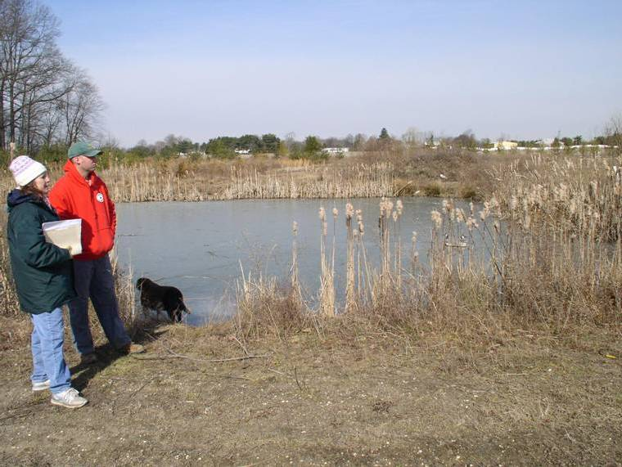
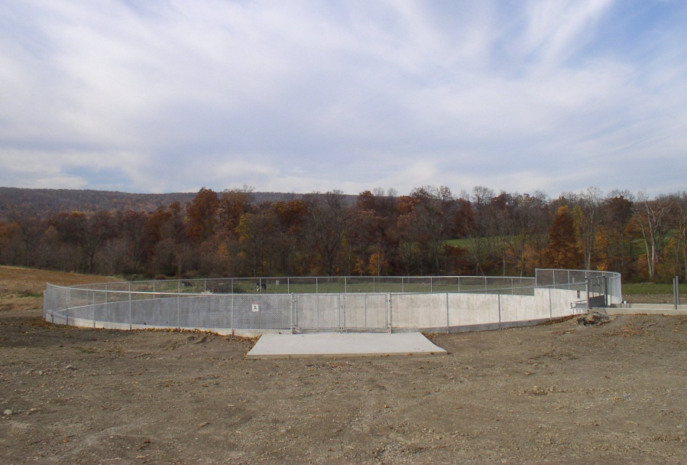
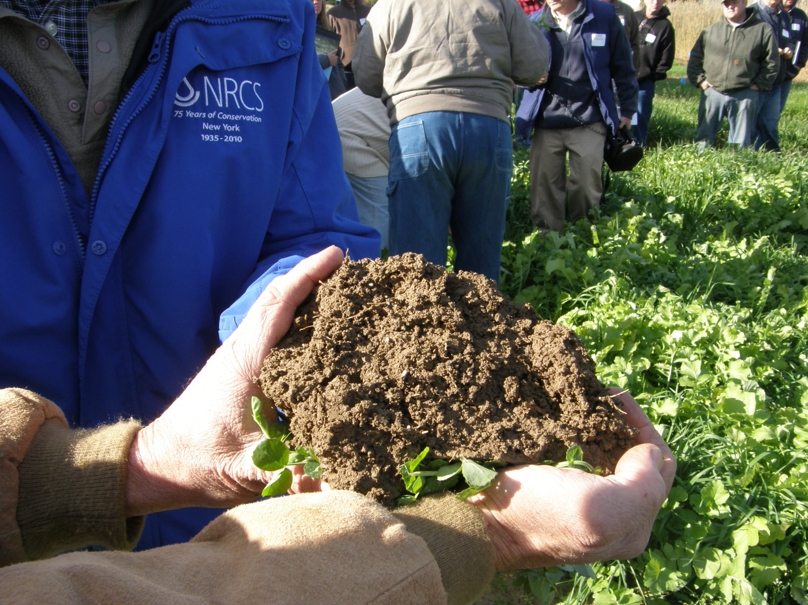
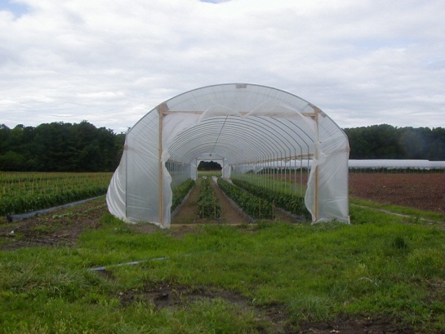

Slide 25
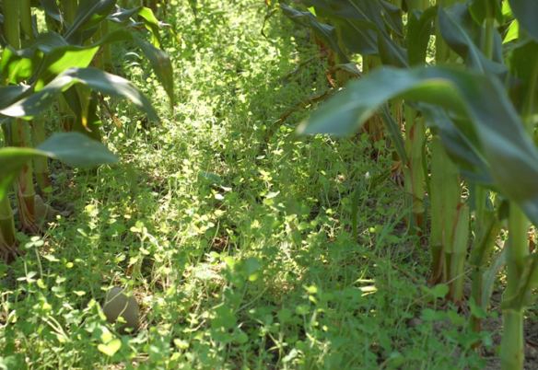
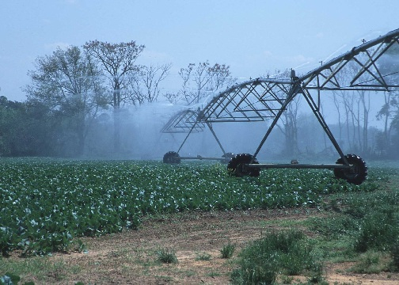
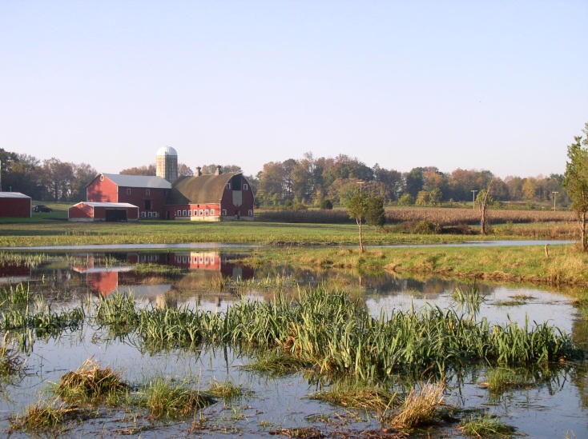

Slide 26
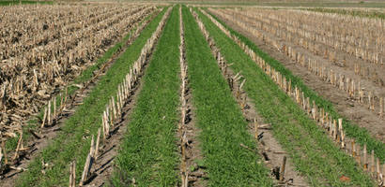
Make the Soil Resilient
Soil Health
Keep the soil covered as much as possible;
Disturb the soil as little as possible;
Keep plants growing throughout the year to feed the soil;
Diversify as much as possible using crop rotation and cover crops
Notes:
A lot of focus since 1936 had been on soil erosion…. Dust bowl, conservation compliance in 1985,…. Now what is exciting is the re-focus or emphasis on soil health. What is soil health? Cover crops have the potential to provide multiple benefits in a cropping system. They prevent erosion, improve soil’s physical and biological properties, supply nutrients, suppress weeds, improve the availability of soil water, and break pest cycles along with various other benefits. The species of cover crop selected along with its management determine the benefits and returns.

